Slide 1
11 things AI experts are watching for in 2026
Week of January 26
Elias Hord

Slide 2
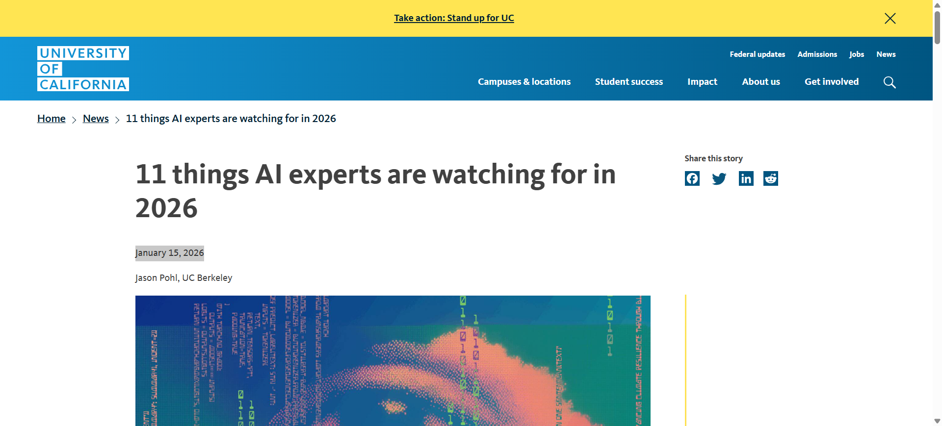
General Information
Article Publication: January 15, 2026
https://www.universityofcalifornia.edu/news/11-things-ai-experts-are-watching-2026

Slide 3
Main Findings and Arguments
• Economic and technological uncertainty: Some researchers question whether the current AI boom is sustainable or a speculative bubble that could burst without major breakthroughs.
• Trust and misinformation: AI-generated media like deepfakes are poised to become routine and widespread, challenging truth, journalism, legal systems, and personal reputation.
• Benefits and innovation: AI is accelerating scientific discovery and offering new personalized technologies, but ethical and responsible deployment must be prioritized.
• Data privacy risks: Massive amounts of personal information shared with chatbots raise concerns about user privacy and how companies might be compelled to disclose logs.
• Social impacts: Companion chatbots could worsen human isolation, especially among youth, without proper safety safeguards.
• Labor and automation: Advances in robotics lag behind hype, particularly for complex manipulation tasks; true human-level physical dexterity remains distant.
• Worker rights: There is growing momentum for legislation protecting workers from invasive AI monitoring and ensuring meaningful human oversight in critical decisions.
• Bias and weaponization: AI tools that evaluate speech or performance can embed systematic bias against neurodivergent speakers or non-standard dialects, potentially harming workers.
• Political neutrality and bias: Defining and ensuring “politically neutral” AI remains a challenge, with potential implications for democracy and public discourse.
• Deepfake proliferation: Highly sophisticated manipulated audio and video will become cheaper and easier to produce, making media literacy and authenticity verification essential.
• Limits of intelligence: Some experts anticipate realizing that general intelligence—human-level or universal AI capability—is not imminent, even as models become more advanced.

Slide 4
Broader Implications for Society
• Erosion of Trust and Truth: With deepfakes and synthetic media becoming commonplace, traditional markers of authenticity (what we see or hear) will no longer be reliable, potentially affecting elections, public trust, courts, and interpersonal relationships.
• Privacy and personal data risk: Individuals may inadvertently share intimate and legally sensitive information with AI systems, prompting legal battles and debates over data ownership and consent.
• Psychological and social health: Increasing reliance on chatbots for emotional support could undermine human empathy and social skills, especially in children and teens.
• Labor market transformation: While robots lag behind hype in replacing many human jobs in 2026, automation and AI systems will still reshape work practices, job roles, and worker protections.
• Democratic processes: Defining and enforcing unbiased AI is crucial to maintain fair political systems and reduce manipulation via algorithms or generated content.
• Policy and regulation: The need for guardrails around AI surveillance, workers’ rights, algorithmic fairness, and content authenticity will likely intensify, influencing legislation globally.
In sum, AI is framed as not just a technological evolution but a societal and ethical crossroad requiring broad engagement by policymakers, civil society, industry, and the public.

Slide 5
Relevance or Potential Influence on the Construction Industry
• Workforce and automation: Construction involves many complex physical tasks—building, manipulation of varied materials, and on-site decision-making—that current AI and robotics are still far from fully mastering. This suggests humans will remain essential in skilled construction roles through 2026, although supportive AI tools may augment workflows.
• Worker monitoring and rights: AI systems that evaluate speech or performance could be deployed in construction project management or safety monitoring, raising concerns about bias, privacy, and fair treatment of workers.
• Safety and tooling: AI could support predictive safety systems, planning optimization, and maintenance diagnostics (e.g., AI agents identifying structural issues), but industry adoption will require balancing innovation with ethical oversight.
• Training and skill development: As AI tools become more integrated into design (BIM), planning, logistics, and workforce coordination, education and upskilling will be critical for construction professionals to leverage these technologies responsibly.
• Trust in digital content: With deepfakes and synthetic data becoming widespread, verifying AI-generated project documentation and plans may become necessary to avoid costly errors or misinformation in contracts, specifications, or compliance reporting.

